Slide 1
Flavours of the World:
How Russian Cuisine Fits Within a Network of Recipes,
Ingredients and Compounds from Around the Globe An analysis on food pairing principles
Dylan Carpenter - 2198288
Alden Bong - 22255844
Luke Carpenter - 22110274

Slide 2
Motivation
We are always on the lookout for new delicious recipes!
As a society, we only utilise a very small portion of the possible ingredient combinations when preparing food.
As such, we seek to identify any general patterns in how ingredient combinations are currently chosen to inform how to create new delicious recipes
As ingredient combinations differ between cultures, we seek to determine which ingredients can bring a nostalgic taste of a favoured cuisine to new ingredient combinations
To examine if flavour networks exhibited scale-free properties

Slide 3
Past Work
¹(Ahn, Ahnert, Bagrow, Barabasi (2011)) creates a flavour network based on mappings between recipes, ingredients and compounds.
The flavour network is used to determine different cuisines' propensity to combine ingredients with shared compounds
The cuisines considered are North American, East Asian, Western European and Southern European
We build on this work by considering the Eastern European cuisine
We also utilise a larger database of ingredients and compounds
(Ahn, Ahnert, Bagrow, Barabasi (2011)) created a network of 381 ingredients and 1,021 flavour compounds
We use a network of 992 ingredients and 112,415 flavour compounds

Slide 4
Dataset Explanation
A website named allrecipes.com has a considerable database of Russian recipes. We scraped, formatted and cleaned this data.
A Kaggle training dataset was also utilized. It can be found at https://www.kaggle.com/kaggle/recipe-ingredients-dataset.
The last dataset is is from the supplementary paper by Ahn, Ahnert, Bagrow, Barabasi. We extracted the "Eastern European" recipes which were not examined in the paper.
These three datasets were combined to form our complete Russian recipe dataset containing 1013 entries.

Slide 5
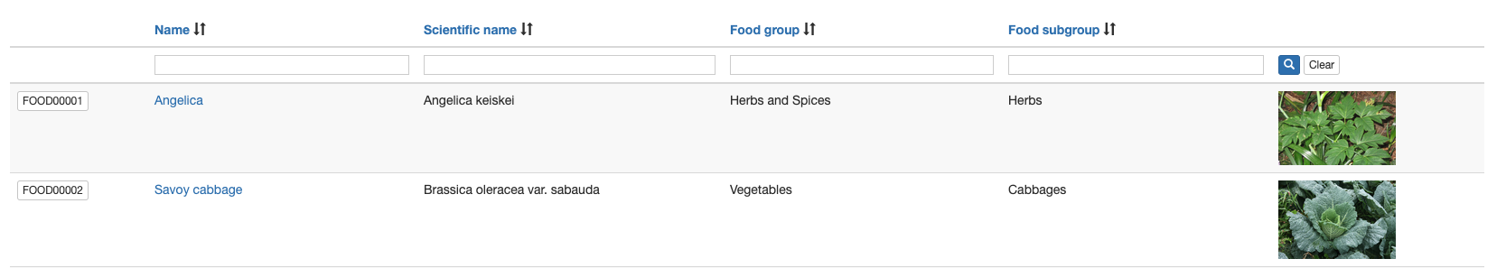
FooDB
FooDB is the world's largest and most comprehensive resource on food.
It provides mappings of food group, food sub-group and scientific names for a wide variety of ingredients.
FooDB is the source of the 992 ingredients and 112,415 flavour compounds

Slide 6
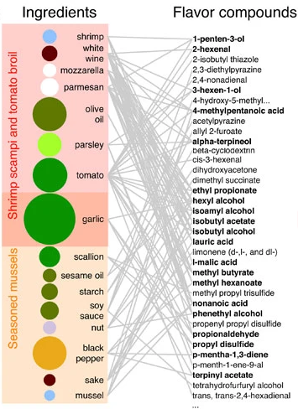
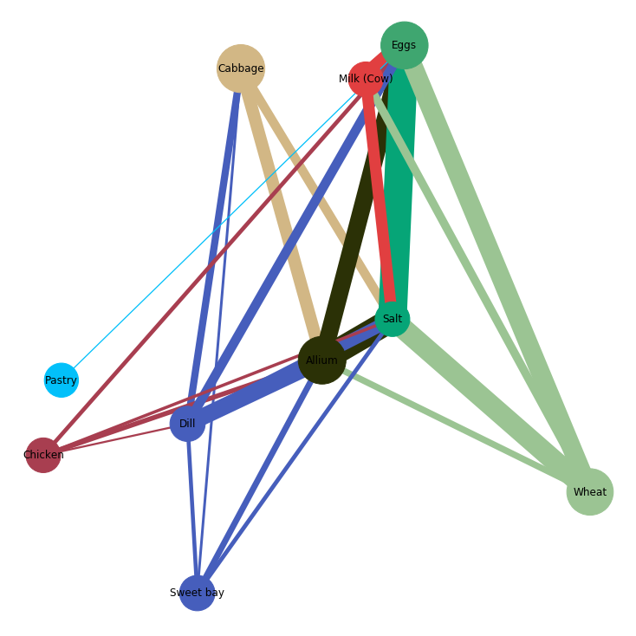
Network Example
Retrieved From Ahn, Y., Ahnert, S., Bagrow, J. & Barabási (2011).

Slide 7
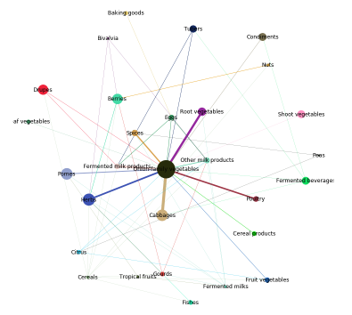
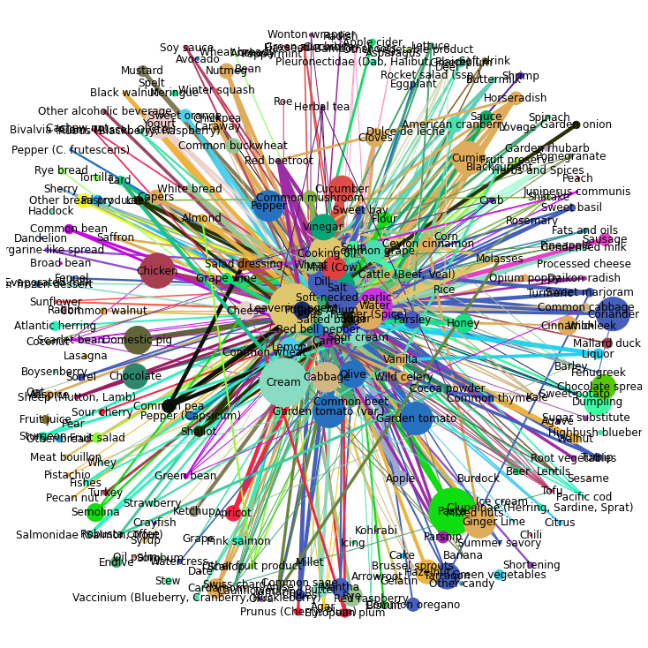
Flavour Network

Slide 8
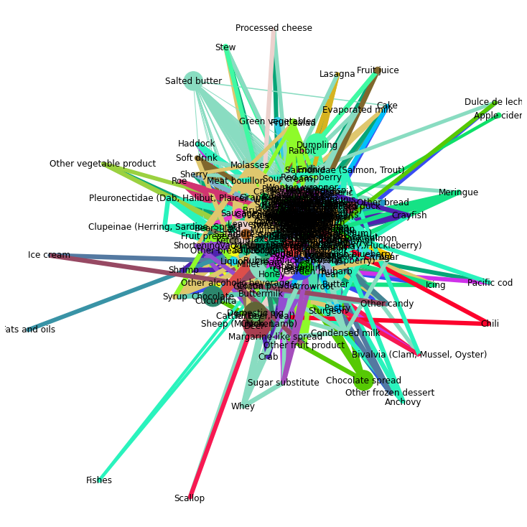
Formulating Compound Pairing As A Network Property

Slide 9
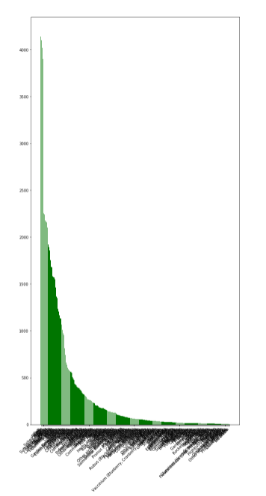
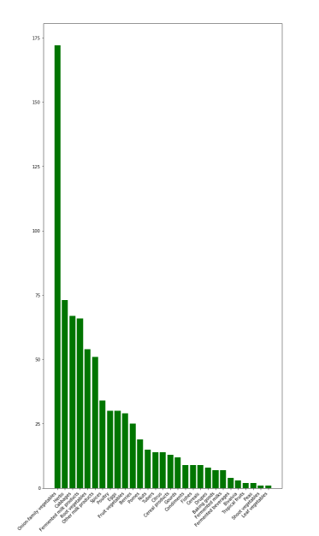
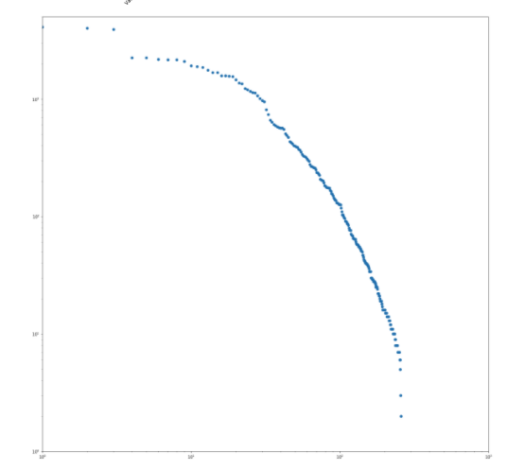
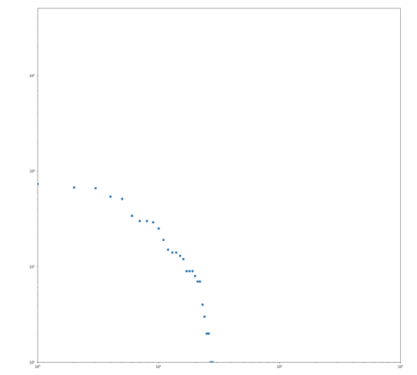
Power Laws!
Ingredient Frequency
Category Frequency

Slide 10
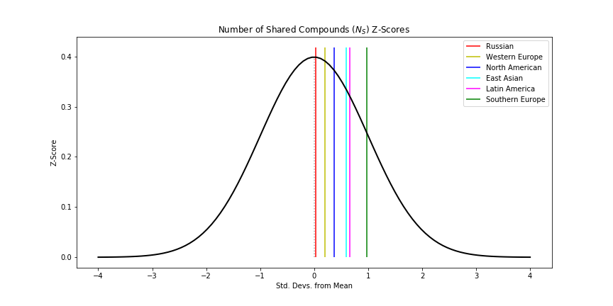
Cuisine Comparison
Compared through the Number of Shared Compounds, N_{s}
The average number of shared compounds between ingredient pairs in a recipe. This is averaged over a cuisine.
Why does this differ from the original paper? Compounds!

Slide 11
Ingredient Authenticity
A measure of how representative a set of ingredients is of a certain cuisine
The prevalence of an ingredient, P_{i}^{c} is defined as the proportion of recipes in cuisine c which contain ingredient i
Authenticity p_{i}^{c} is the difference between the prevalence of an ingredient in one cuisine and the average prevalence in all others
This process is identical for find the authenticity of ingredient pairs p_{ij}^{c}

Slide 12
Ingredient Authenticity
Cuisine | Single Ingredient | Ingredient Pair
East Asian | Allium, Soy sauce, Soft-necked garlic, rice, sesame, pepper (Capsicum) | (Allium, Soft-necked garlic), (Allium, Soy sauce), (Soft-necked garlic, Soy sauce), (Allium, Sesame), (Soy sauce, Sesame), (Allium, Pepper (Capsicum))
North American | Salted Butter, Eggs, Common Wheat, Allium, Red bell pepper, Soft-necked garlic | (Common wheat, Eggs), (Common wheat, Salted butter), (Eggs, Salted butter), (Allium, Red bell pepper), (Allium, Soft-necked garlic), (Common wheat, Milk (Cow)
Russian | Salted butter, Common wheat, Eggs, Allium, Cream, Red bell pepper | (Common wheat, Eggs), (Common wheat, Salted butter), (Salted butter, Eggs), (Allium, Red bell pepper), (Eggs, Milk (Cow)), (Common wheat, Milk (Cow))

Slide 13
References
1.Ahn, Y., Ahnert, S., Bagrow, J. & Barabási, A. Flavor network and the principles of food pairing. Scientific Reports 1, (2011).

